Slide 1
Software Engineering
Smart shoes care
Shoes care solution utilizing IOT concept
June the 17th 2016
Hanyang University
2012004593 Shin Min Ki
2012004377 Ko Byunghee
2012004407 Kim JungHyun
2012004515 Kwon GyuHyeok

Slide 2

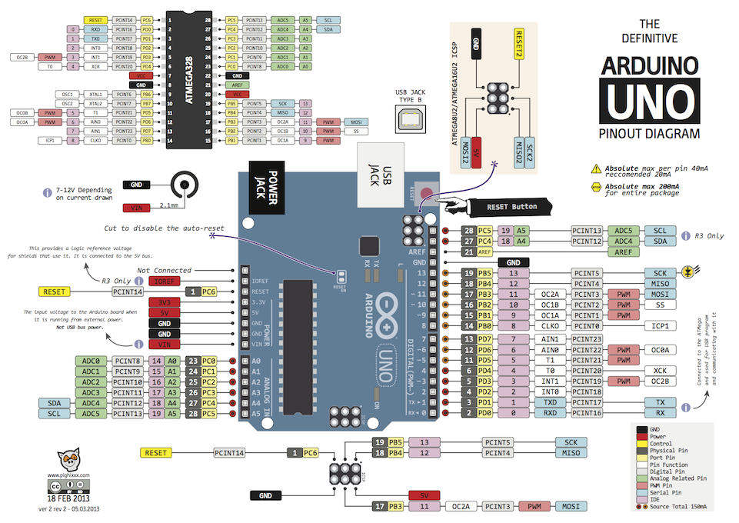
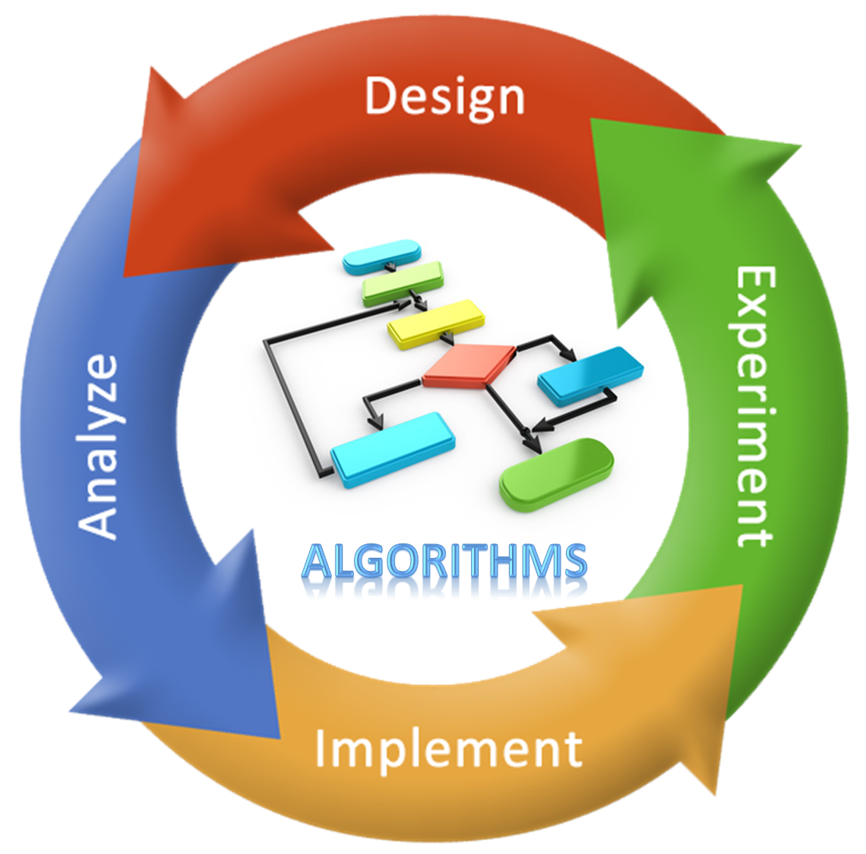

01
02
03
04
05
01
Introduction
Introduction
Customer Needs
function
USE CASES
Summary
care of shoes
periodically automatically
Smart shoes care
Optimizing
environment
Smart shoes care(IOT)
Recommendation
Algorithm
Analysis function

Slide 3
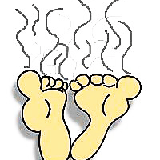
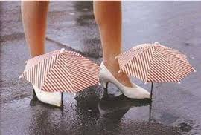
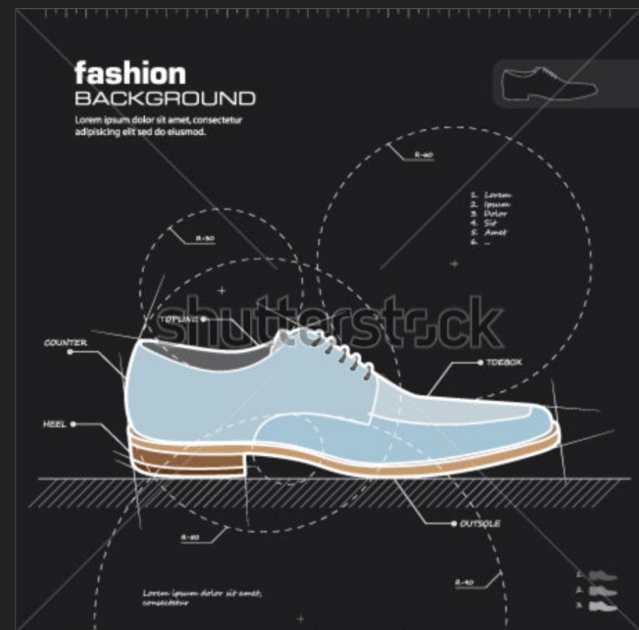
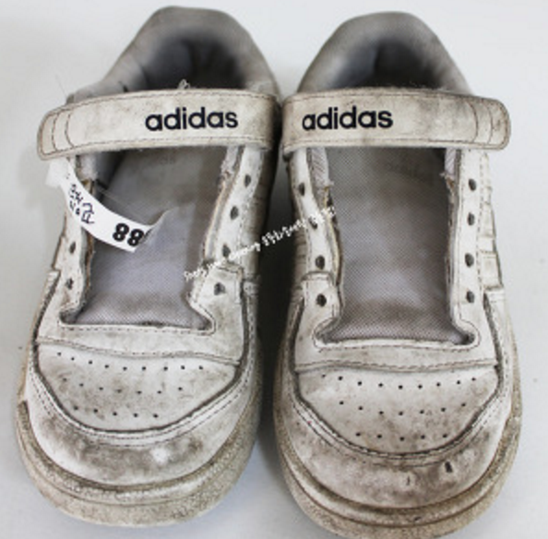
01
02
03
04
05
02
Customer Needs
Introduction
Customer Needs
function
USE CASES
Summary
Reasons of smart shoes
Care making
tough task to manage
Odor problem
Difficulty of Drying
and cleansing
Short Information
Difficulty of take care of my shoes periodically

Slide 4
01
02
03
04
05
03
Function
Introduction
Customer Needs
function
USE CASES
Summary
. Optimizing environment
1. Arduino technology
using sensor -> get information
2. wi-fi technology
make order to fan , lamp , deodrant , sterilizer on/off
pressure sensor
-usage time
-Shoes on/off
Temperature/humidity sensor
-trmperature
-humidity
-Electric fan
-Ultraviolet lamp
-Deodorant
-Sterilizer
Web
Wi-fi

Slide 5
01
02
03
04
05
03
Function
Introduction
Customer Needs
function
USE CASES
Summary
. Optimizing environment
automatic
1. Automatic shoes care
Sensor get information
Temperature control – using electric fan (Automatic)
Humidity control -through ultraviolet lamp (Automatic )
Inspection in program
Deodorization function – using deodorant(Automatic)
program operation
Sterilization function - using sterilizer(Automatic)
Function on/off

Slide 6
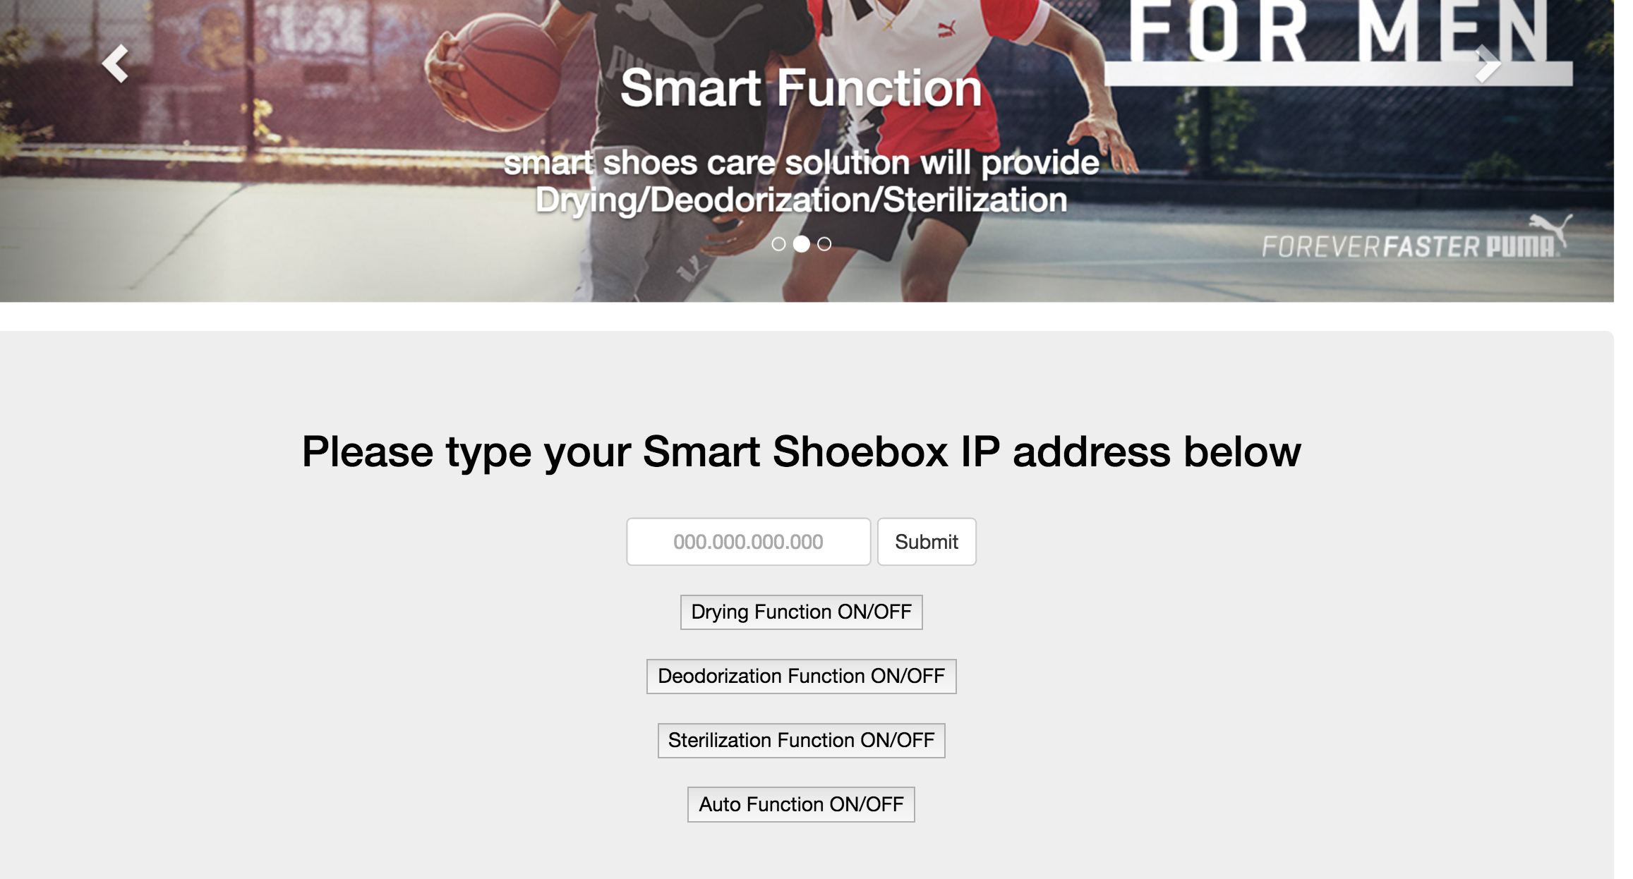

Slide 7
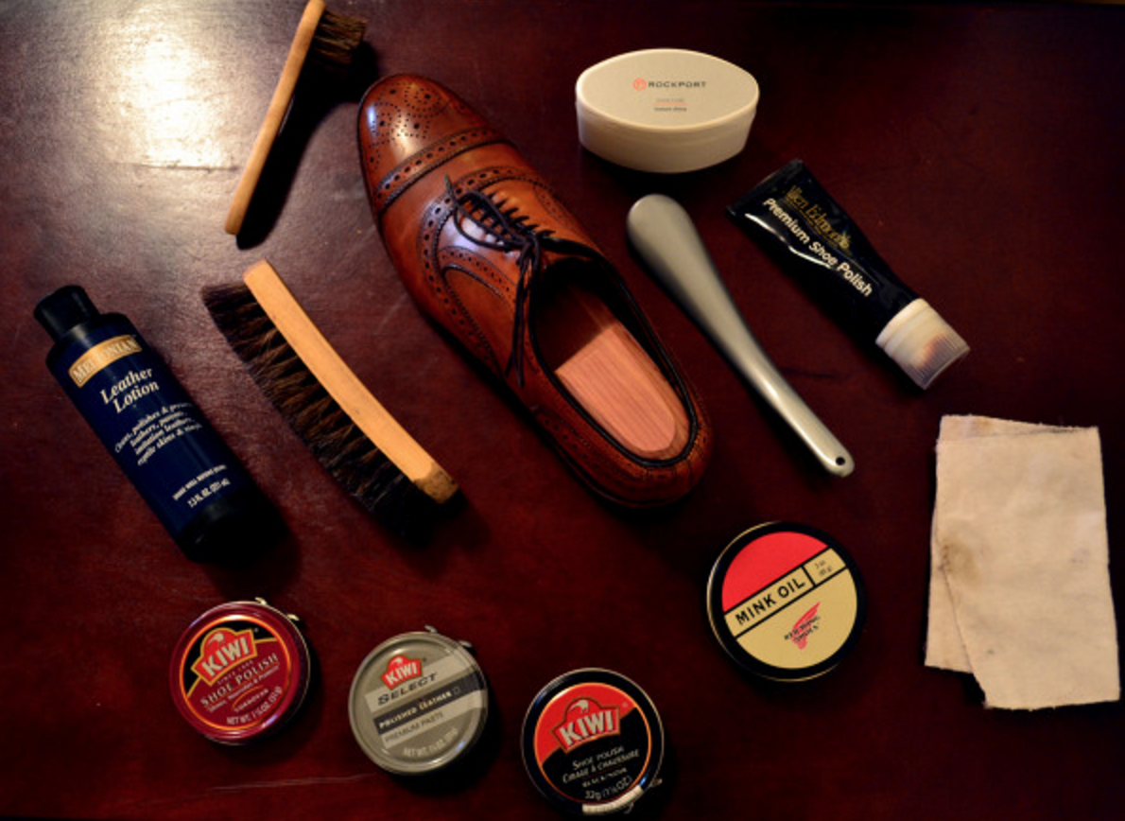
01
02
03
04
05
03
Function
Introduction
Customer Needs
function
USE CASES
Summary
. Optimizing environment
On damand
2 Smart function
User needs
In this function user can control the environment each shoes case on demand . Through this function user can do intensive Drying(after cleansing or rain sweat) , shoes warm , deodorization, Sterilization etc.. (병휘형 영어좀 봐죠용,…ㅜㅜㅜㅜ )
Cilck on Web
WI-FI
Hands-operated
Function on
Automatic

Slide 8
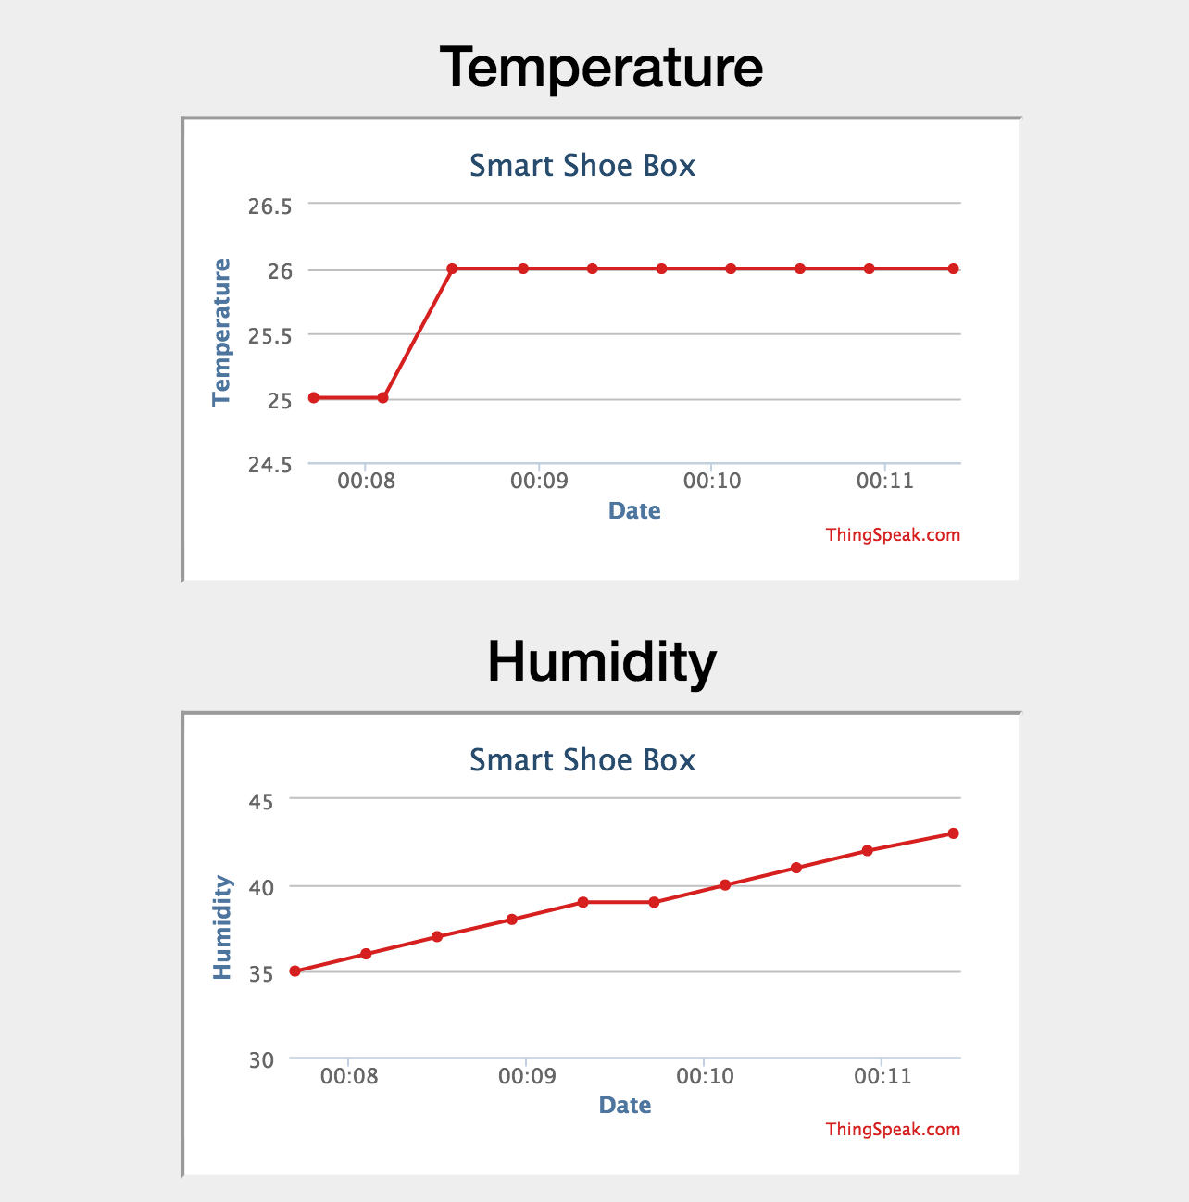

Slide 9

01
02
03
04
05
03
Function
Introduction
Customer Needs
function
USE CASES
Summary
Analysis function
3.My shoebox -> In this function you can check your own shoes state
Based on pressure sensor information and database we give shoes state, capacity
- Customer just enter the shoes-type , color and name
color
watersensitivity
odorsensitivity
preference
transaction
activity
weight
warmth
predictedlife

Slide 10
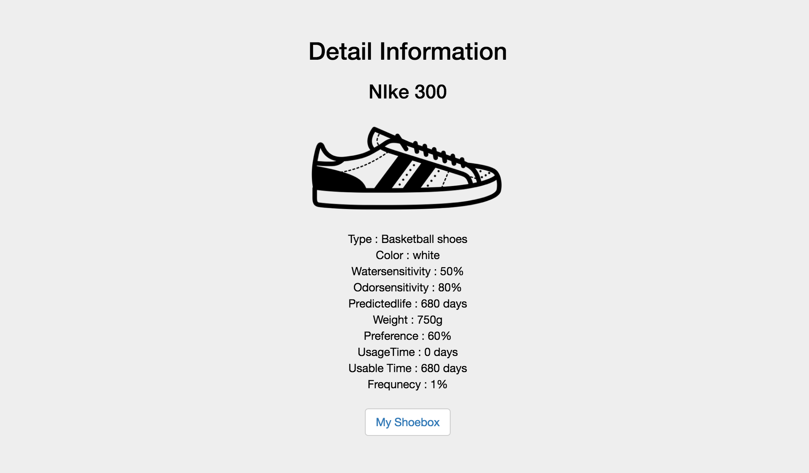
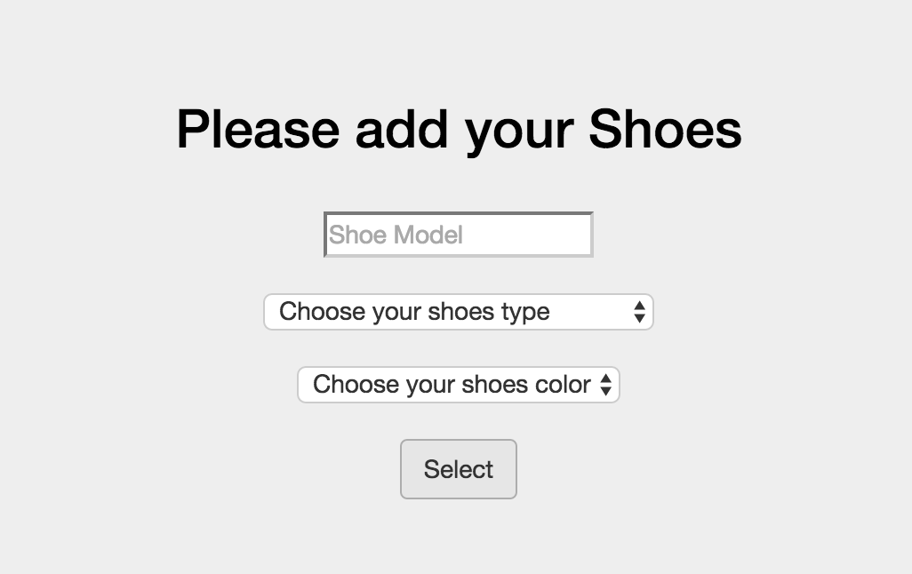

Slide 11
01
02
03
04
05
03
Function
Introduction
Customer Needs
function
USE CASES
Summary
Shoes recommendation
4.Recommendation - stand on the basis of shoes capacity and weather and user schedule and Algorithm – measurement index
Shoes capacity(database)
Shoes warmth
Shoes activity
Shoes color
Present weather(API on Web
Rain , snow , cloud etc
Warmth , cold

Slide 12
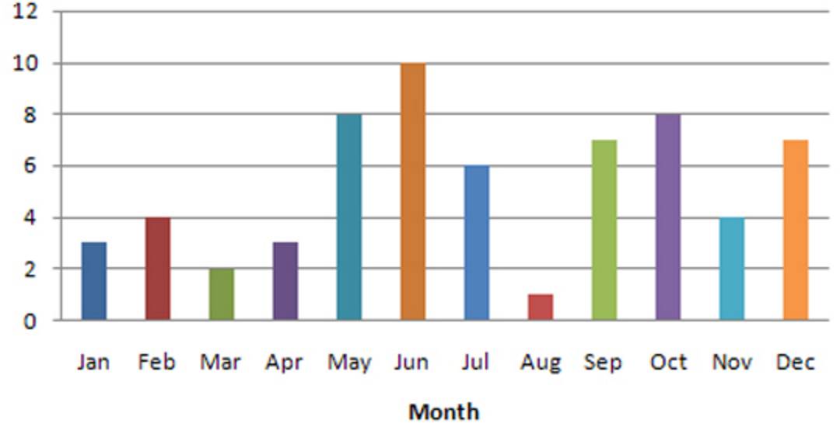
01
02
03
04
05
03
Function
Introduction
Customer Needs
function
USE CASES
Summary
Shoes recommendation
4.Recommendation - stand on the basis of shoes capacity and weather and user schedule and Algorithm - measurement index
user schedule
-based on user’stype of schedule
- Todays activity type
User Preference
-base on statistic(pressure sensor)
- Usage of month

Slide 13
01
02
03
04
05
03
Function
Introduction
Customer Needs
function
USE CASES
Summary
Weather confirmation
5. Weather confirmation
- With weather API, user can confirm local weather
Rain?
Snowing?
Cloud?
Later?
Warm?
Cold?
Hot?
At afternoon

Slide 14
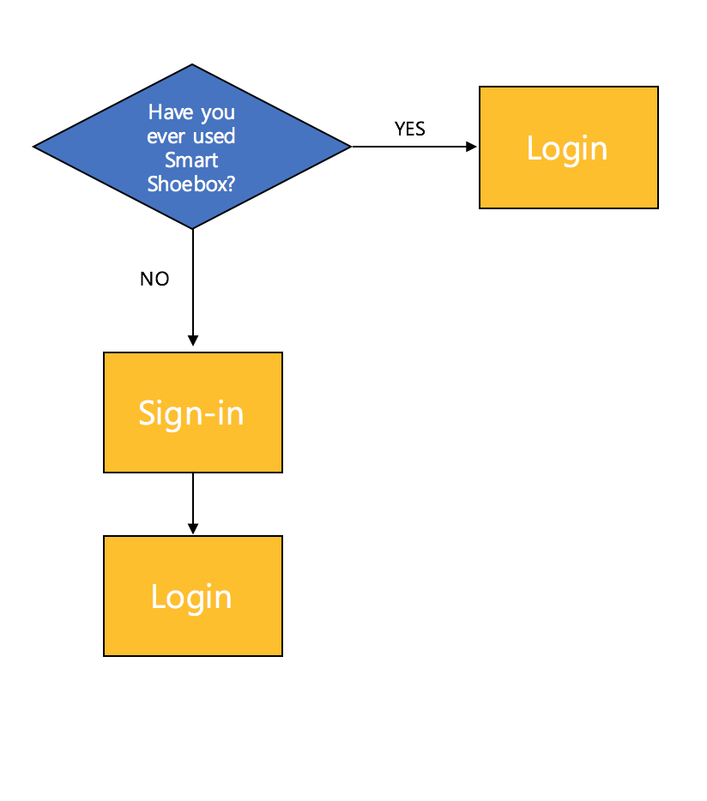
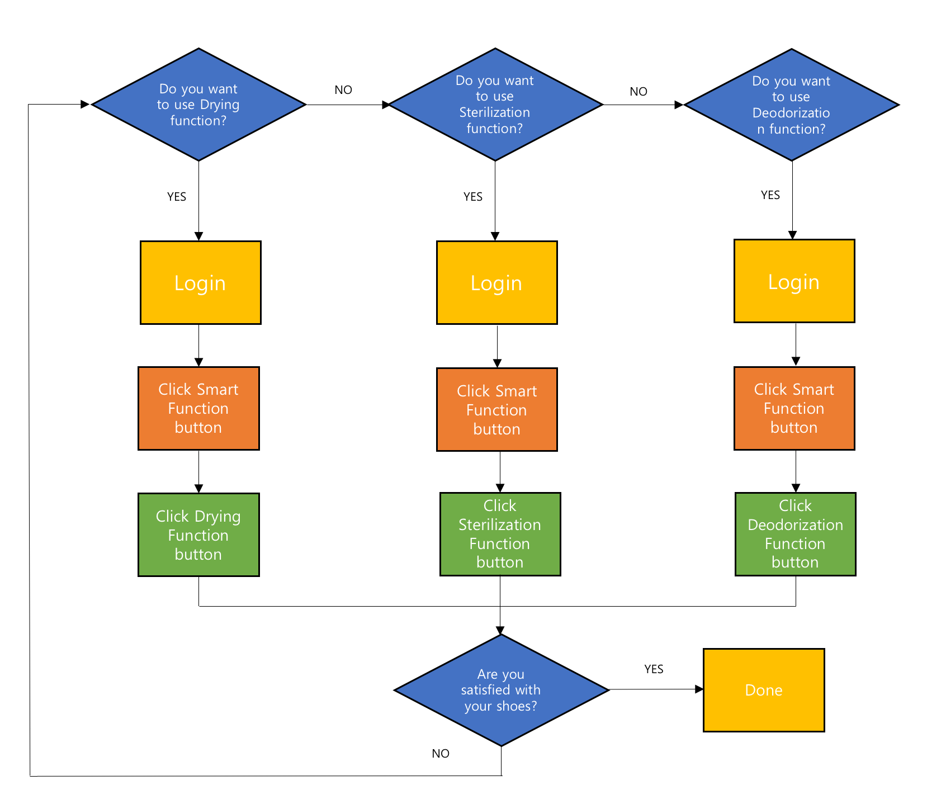
01
02
03
04
05
04
Use case
Introduction
Customer Needs
function
USE CASES
Summary
Use case
Starting smart shoebox
Operate smart function

Slide 15
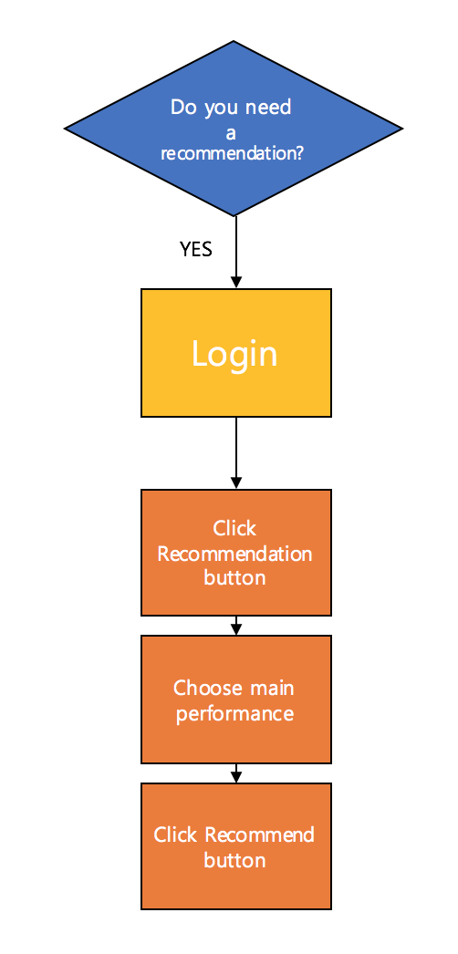
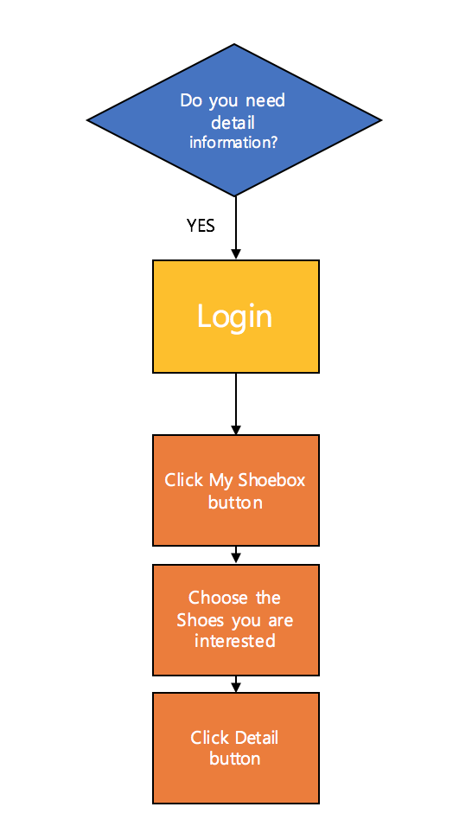
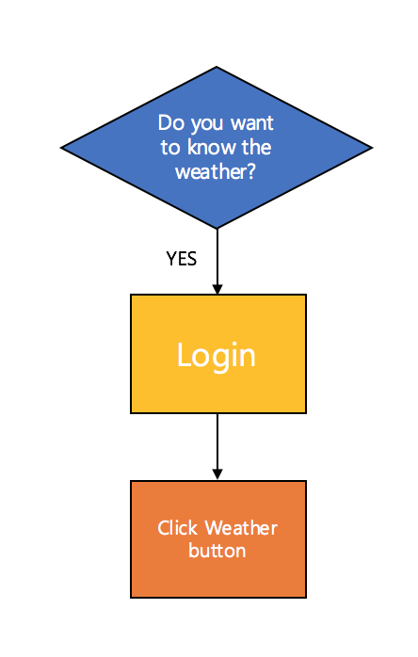
01
02
03
04
05
04
Use case
Introduction
Customer Needs
function
USE CASES
Summary
Use case
Shoes recommendation
My shoebox - information
Weather confirmation

Slide 16
01
02
03
04
05
05
demonstration
Introduction
Customer Needs
function
USE CASES
demonstration
public demonstration
http://localhost:3000/

